Slide 1
Project 3: Robot Manipulator Collision Avoidance Path Planning
Ng Wei Jie Brandon
Zheng Jie Zhi
Zhao Heng Yuan

Slide 2
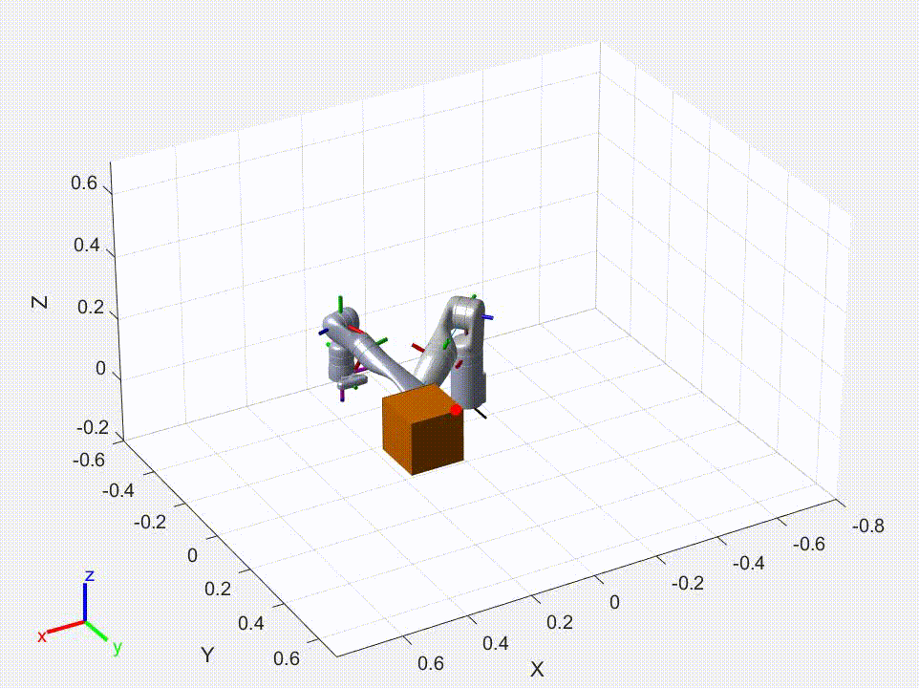
Task 1: Robot Trajectory

Slide 3
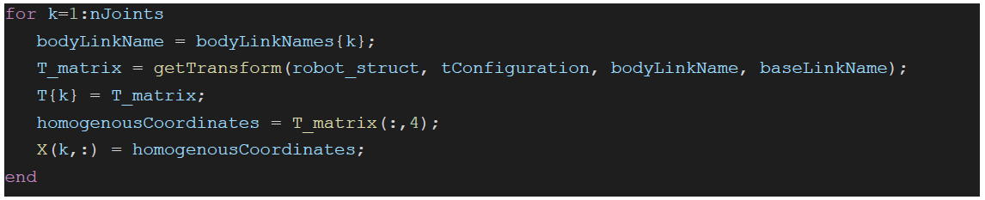
Task 1: Update Joint World Position

Slide 4
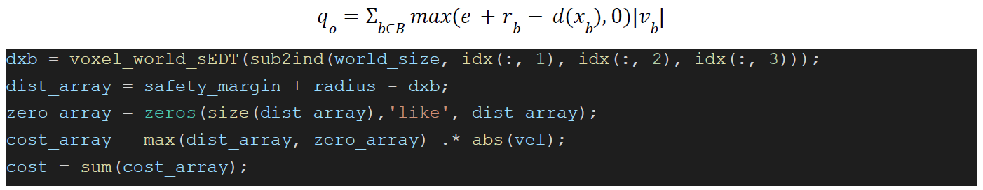
Task 1: Stomp Obstacle Cost

Slide 5
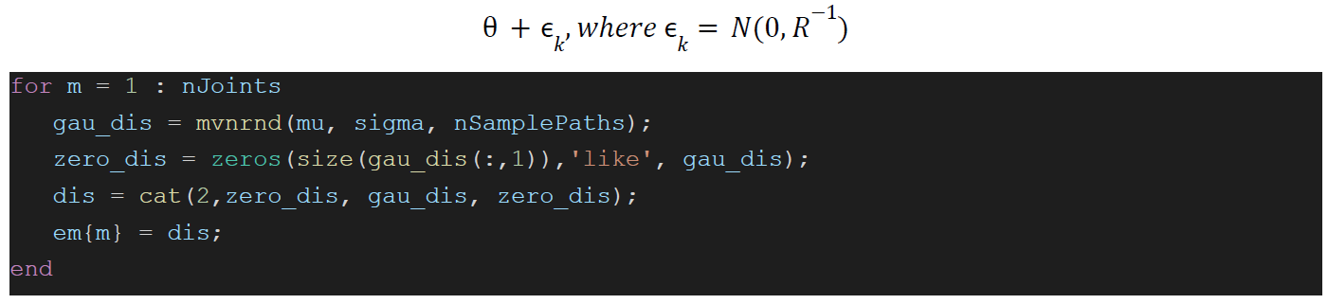
Task 1: Stomp Samples

Slide 6
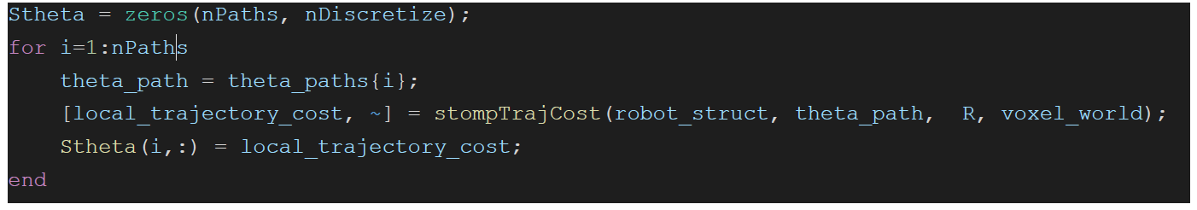
Task 1: Local Trajectory Cost

Slide 7
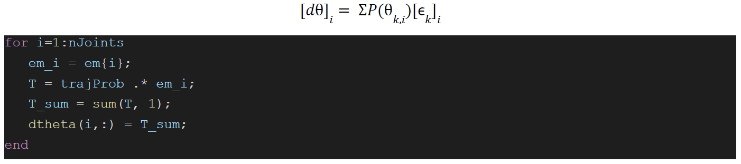
Task 1: Stomp Dtheta

Slide 8
Task 1: Stomp Update Theta

Slide 9
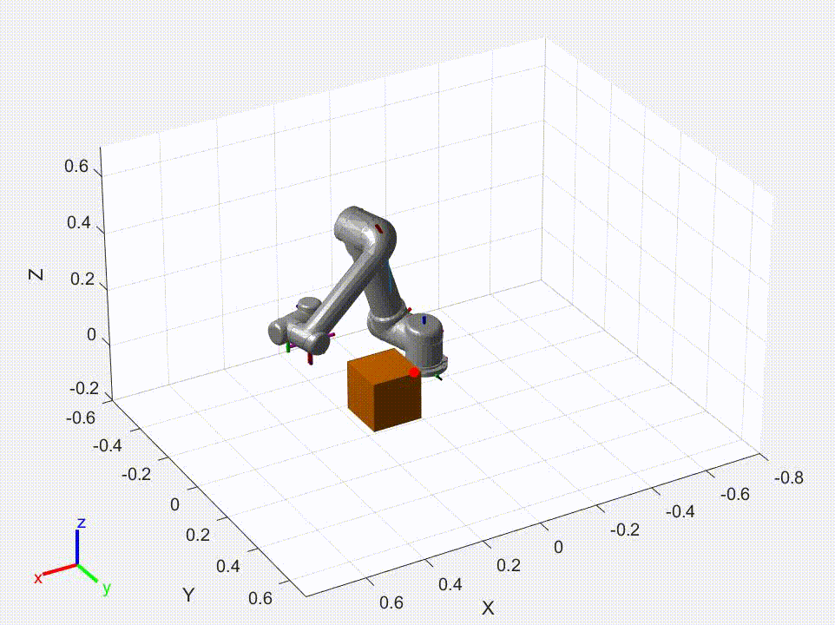
Task 2: Robot Trajectory 0f “universalUR5" Manipulator

Slide 10
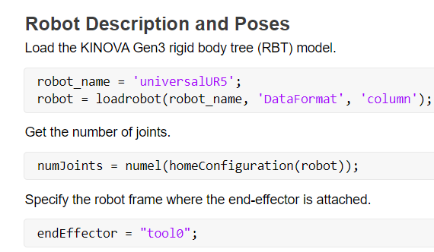
Task 2: Robot Trajectory 0f “universalUR5" Manipulator
Change the name of manipulator
Identify the end effector of new manipulator

Slide 11
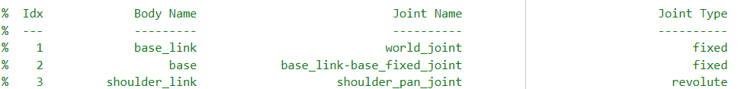
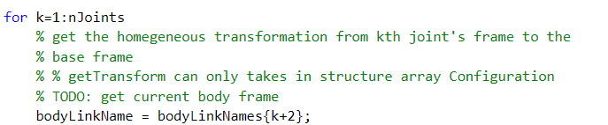
Task 2: Robot Trajectory 0f “universalUR5" Manipulator
Fixed joints
(k+2) starts from the revolute joints for body frame

Slide 12

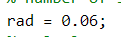
Task 2: Robot Trajectory 0f “universalUR5" Manipulator
Increase the safety margin and sphere radius to 0.06

Slide 13
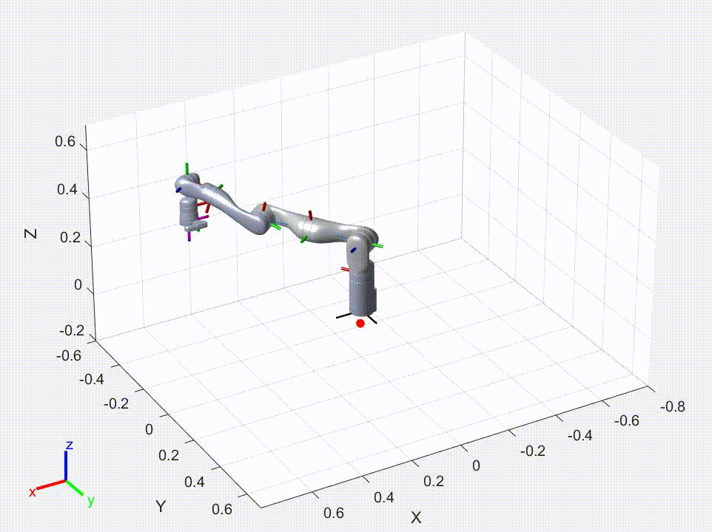
Task 3: Robot Trajectory (1)

Slide 14
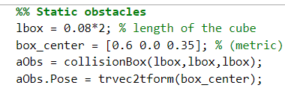
Task 3: Robot Trajectory (2)
Set the coordinates of the top obstacle

Slide 15
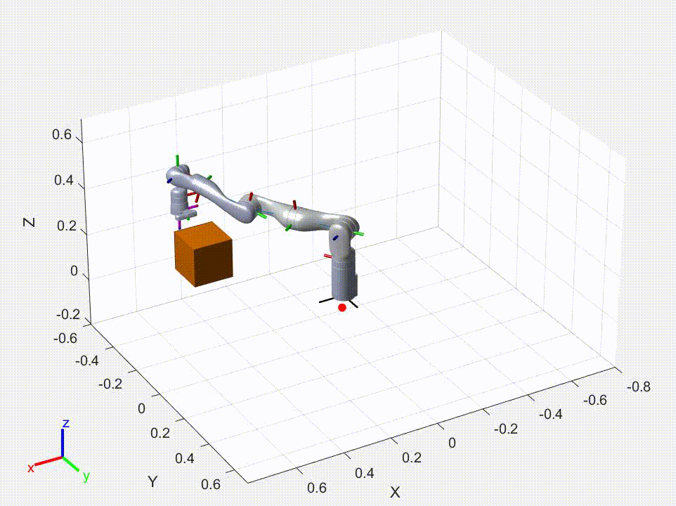
Task 3: Robot Trajectory (2)

Slide 16
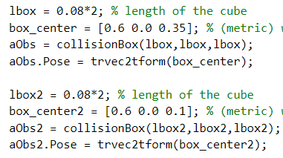
Task 3: Robot Trajectory (3)
Set the coordinates of the bottom obstacle

Slide 17
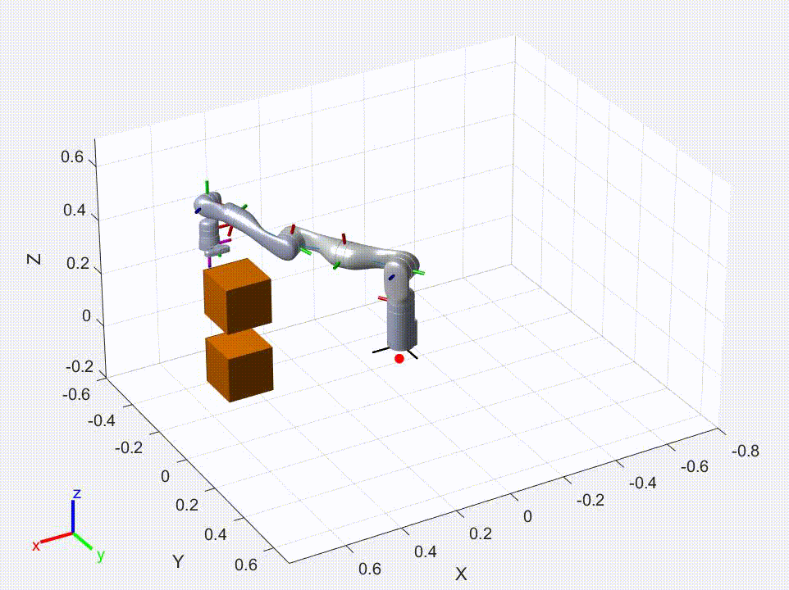
Task 3: Robot Trajectory (3)

Slide 18
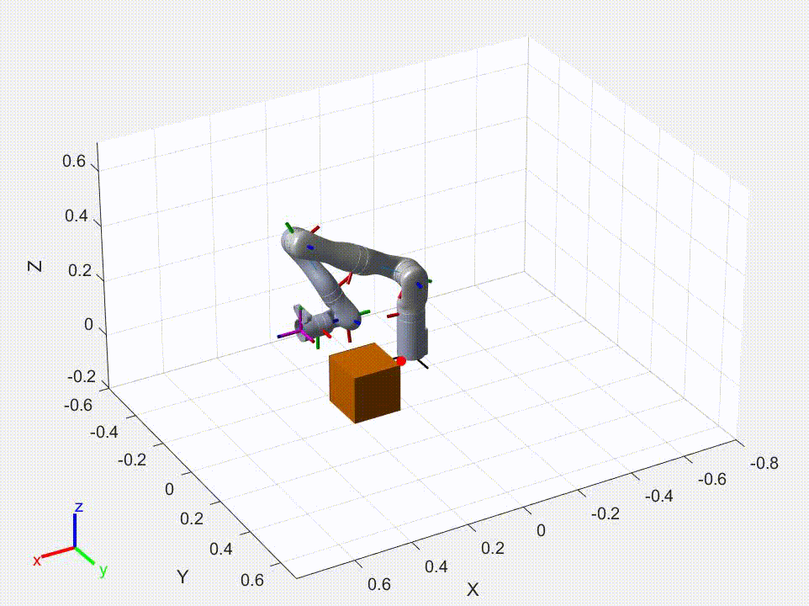
Task 4: Robot Trajectory

Slide 19
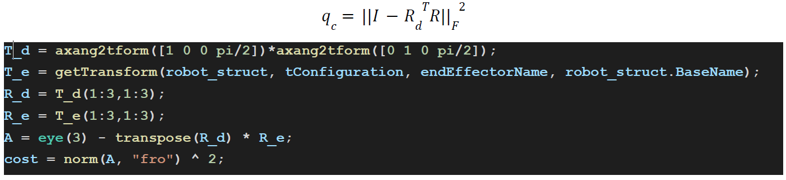
Task 4: Stomp Constraint Cost

Slide 20
Task 4: Local Trajectory Cost

Slide 21
Task 5: Robot Trajectory

Slide 22
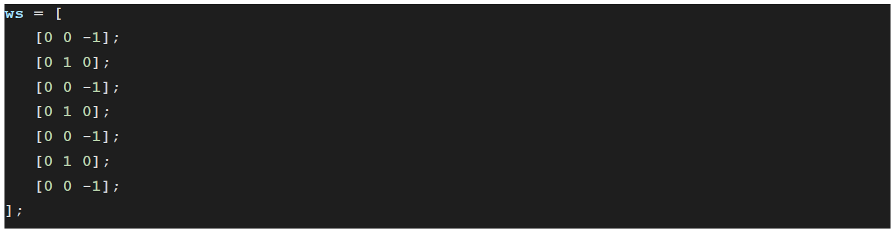
Task 5: Screw Axis

Slide 23
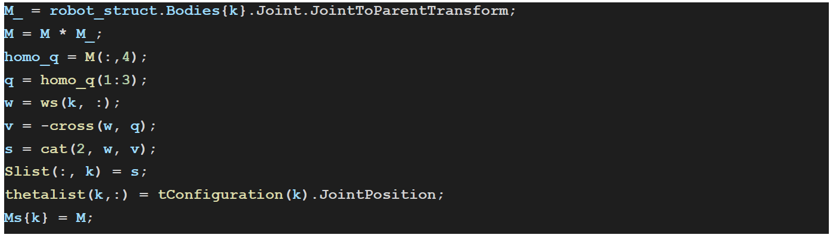
Task 5: Screw Axis And Current Config

Slide 24
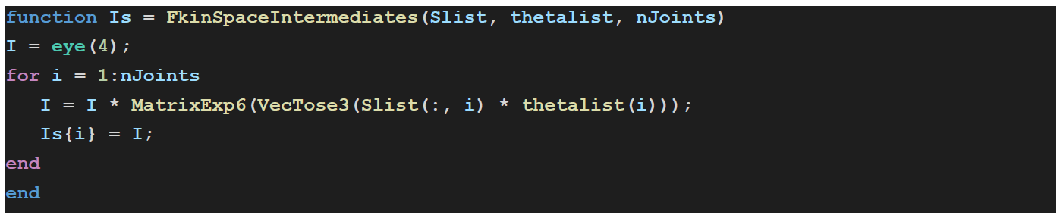
Task 5: FkinSpace

Slide 25
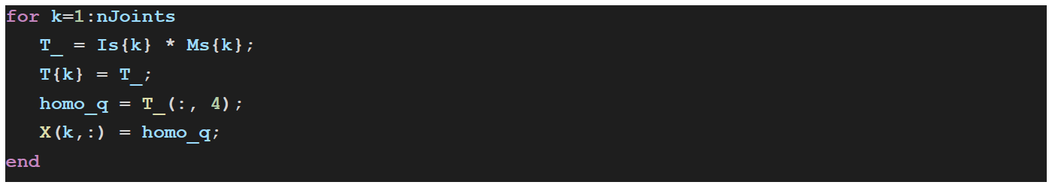
Task 5: Transformation Matrices

Slide 26
Bonus 1:Robot Trajectory
Sweep Across the whole plane

Slide 27
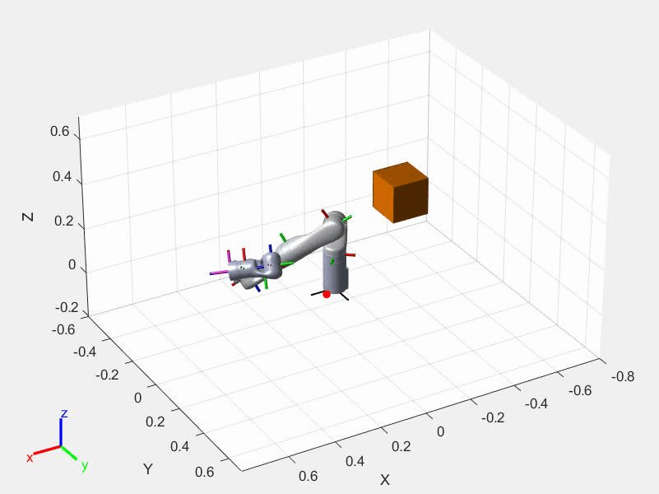
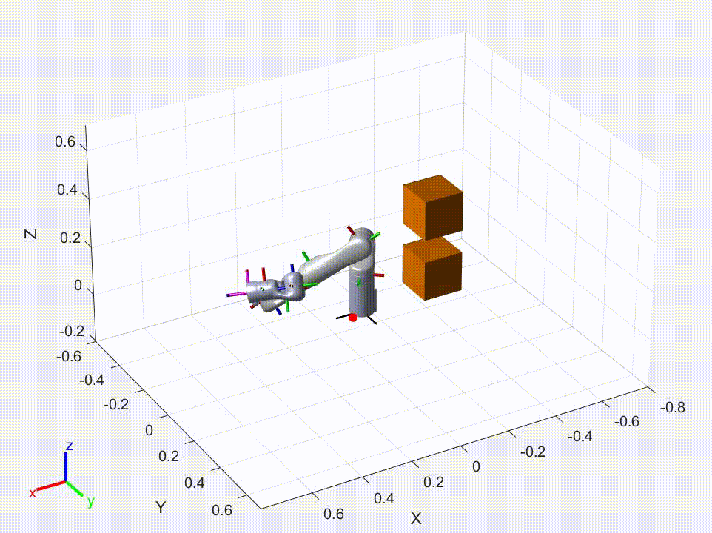
Bonus 1:Robot Trajectory

Slide 28
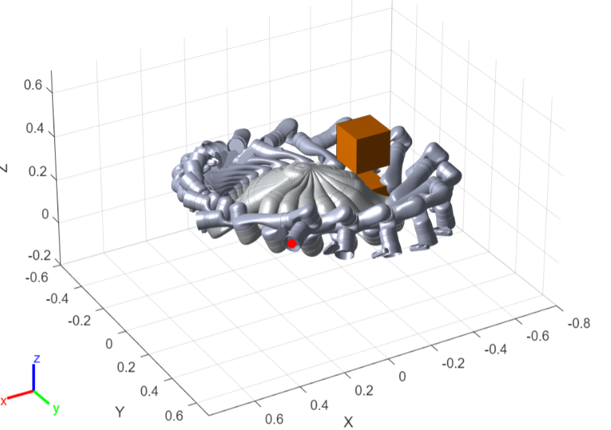
Bonus 1:Robot Trajectory

Slide 29
Bonus 2: Robot Trajectory

Slide 30
Robot 2: Covariance Matrix

Slide 31
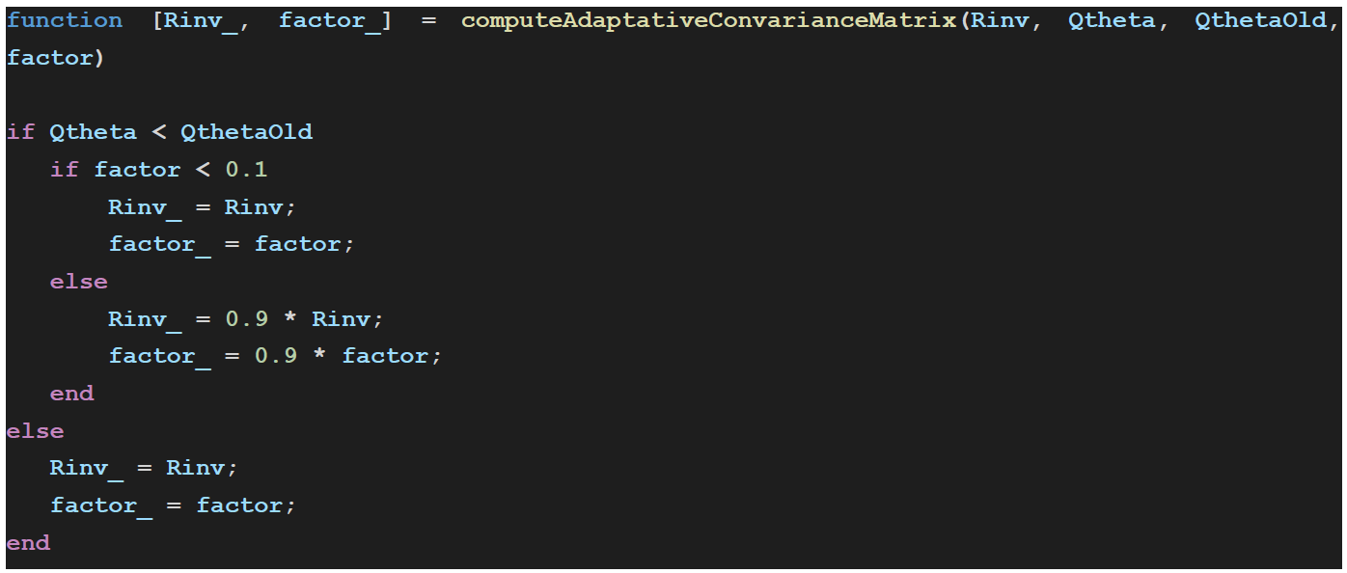
Robot 2: Adaptive Covariance Matrix

Slide 32
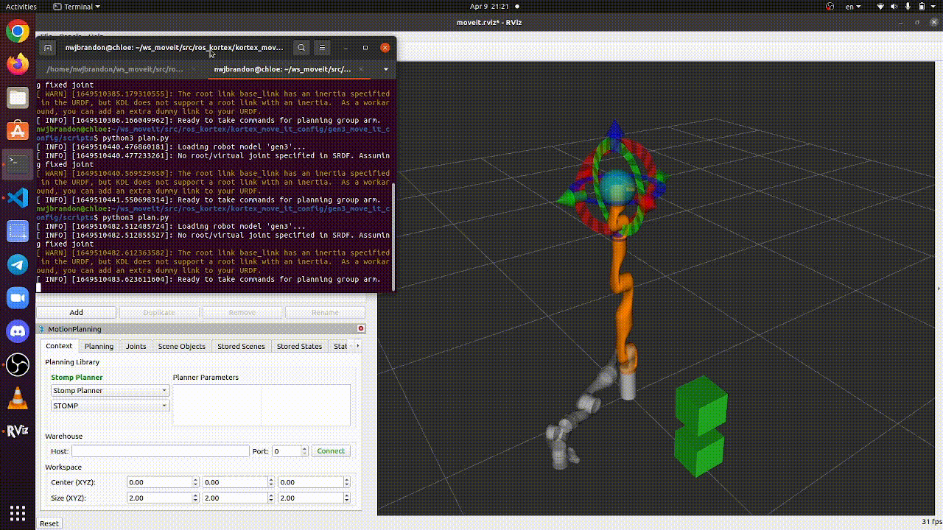
Robot 3: Robot Trajectory

